Slide 1

REVIEWING SUPERHERO AD CAMPAIGNS
Recommending Ads to Discontinue to Save Money

Slide 2
TEAM MEMBERS
SUPRAJA MANNAVA
ADEBAYO IDRIS
AJOSE BALIKIS
AKIN ADIGUN
BOYAPATI SAIGANESH
ABIOLA ODUOLA
EZE JUNIOR
CHUKWUBUIKEM JUSTIN OFODILE

Slide 3

Introducton
Driven towards instilling a sense of innovation and inventiveness among our youth, Superhero U was an endeavour to empower imaginative and fervent young minds to make the best possible use of their skills and creativity. Influenced by the UN's mission “to promote prosperity while protecting the planet”, Superhero U was a competitive event that was targeted towards providing an encouraging and equal educational opportunity to the budding stars.

Slide 4
AIM
Superhero U events has several ad campaigns. We need to recommend some to discontinue so as to save money

Slide 5
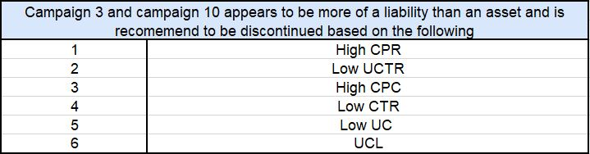
Discovery

Slide 6
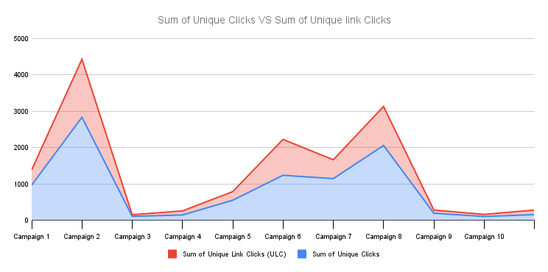
Sum of Unique Clicks VS Sum of Unique Link Clicks

Slide 7
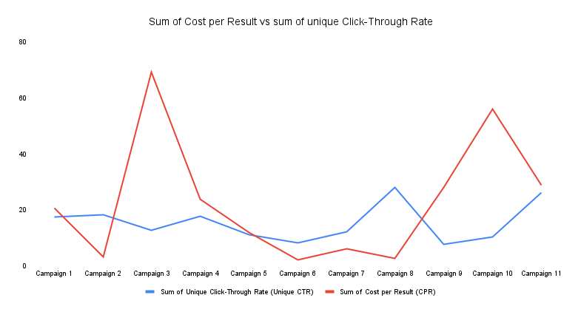
Sum of Cost Per Result VS Sum of Unique Click-Through Rate

Slide 8
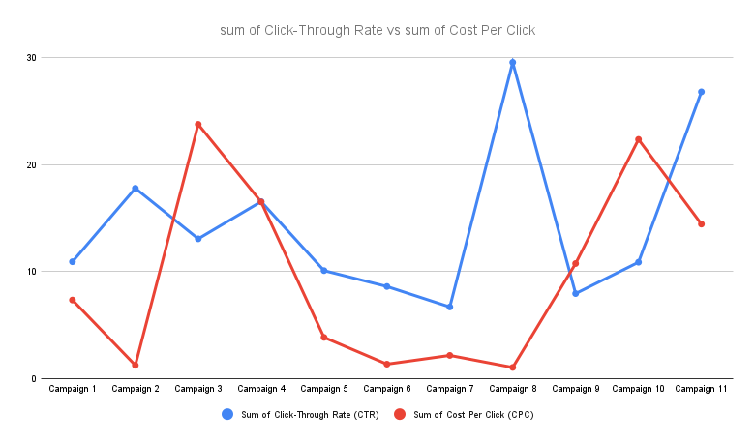
Sum of Click – Through Rate VS Sum of Cost Per Click

Slide 9
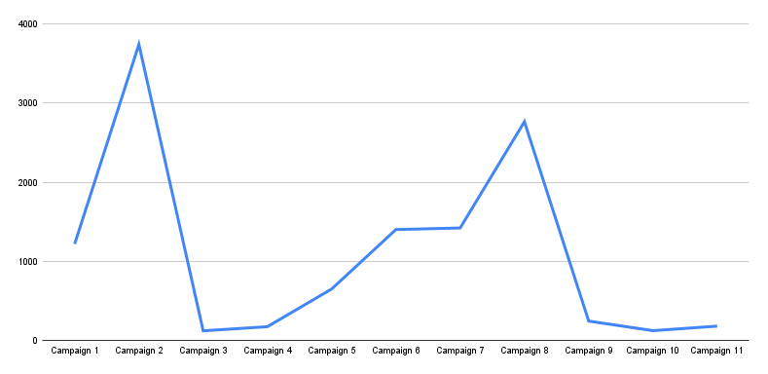
Sum of Click

Slide 10
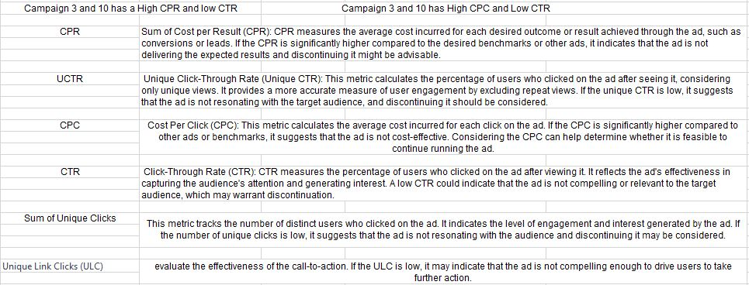
SOLUTION

Slide 11
Conclusion
We recommend that Campaign 3 and 10 be discontinued……
Thank You

